Slide 1

Neural Networks and Deep Learning
Perceptron – MLP – Some applications
Presented by
Dr. T. Hitendra Sarma
Associate Professor
Department of Information Technology
Vasavi College of Engineering, Hyderabad

Slide 2
Topics
A quick look at history
The Perceptron
Multilayer networks
Some Applications

Slide 3
Artificial Neural Networks
Other terms/names
    connectionist
    parallel distributed processing
    neural computation
    adaptive networks..
History
  1943-McCulloch & Pitts are generally recognised as the designers of the first neural network
  1949-First learning rule
  1969-Minsky & Papert - perceptron limitation - Death of ANN
  1980’s - Re-emergence of ANN - multi-layer networks

Slide 4
The Structure of Neurons
A neuron has a cell body, a branching input
structure (the dendrIte) and a branching output structure (the axOn)
  Axons connect to dendrites via synapses.
  Electro-chemical signals are propagated from the dendritic input, through the cell body, and down the axon to other neurons

Slide 5
The Artificial Neuron (Perceptron)
a_{o}
+1
w_{j0}
a₁
w_{j1}
w_{j2}
a₂
S_{j}
f(S_{j})
X_{j}
w_{jn}
a_{n}

Slide 6

A Simple Model of a Neuron (Perceptron)
y₁
w_{1j}
y₂
w_{2j}
w_{3j}
O
y₃
y_{i}
w_{ij}
Each neuron has a threshold value
Each neuron has weighted inputs from other neurons
The input signals form a weighted sum
If the activation level exceeds the threshold, the neuron “fires”

Slide 7
An Artificial Neuron
y₁
w_{1j}
y₂
w_{2j}
w_{3j}
f(x)
O
y₃
y_{i}
w_{ij}
Each hidden or output neuron has weighted input connections from each of the units in the preceding layer.
The unit performs a weighted sum of its inputs, and subtracts its threshold value, to give its activation level.
Activation level is passed through a sigmoid activation function to determine output.

Slide 8
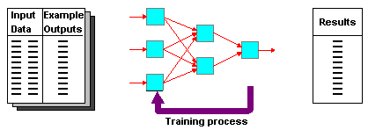
Supervised Learning
Training and test data sets
Training set; input & target

Slide 9
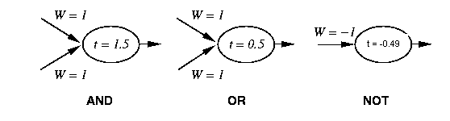
Perceptron Training
1 if Σ w_{i} x_{i} >t
Output=
0 otherwise
{
_{i=0}
Linear threshold is used.
W - weight value
t - threshold value

Slide 10
Simple network
1 if Σ w_{i}x_{i} >t
output=
0 otherwise
{
AND with a Biased input
_{i=0}
-1
W₁ = 1.5
X
W₂ = 1
t = 0.0
W₃ = 1
Y

Slide 11
Learning algorithm
While epoch produces an error
  Present network with next inputs from epoch
  Error = T – O
  If Error <> 0 then
    W_{j} = W_{j} + LR * I_{j} * Error
  End If
End While

Slide 12
Learning algorithm
Epoch : Presentation of the entire training set to the neural network.
In the case of the AND function an epoch consists of four sets of inputs being presented to the network (i.e. [0,0], [0,1], [1,0], [1,1])
Error: The error value is the amount by which the value output by the network differs from the target value. For example, if we required the network to output 0 and it output a 1, then Error = -1

Slide 13
Learning algorithm
Target Value, T : When we are training a network we not only present it with the input but also with a value that we require the network to produce. For example, if we present the network with [1,1] for the AND function the target value will be 1
Output , O : The output value from the neuron
Ij : Inputs being presented to the neuron
Wj : Weight from input neuron (I_{j}) to the output neuron
LR : The learning rate. This dictates how quickly the network converges. It is set by a matter of experimentation. It is typically 0.1

Slide 14
Training Perceptrons
For AND
A B Output
0 0 0
0 1 0
1 0 0
1 1 1
-1
W₁ = ?
x
t = 0.0
W₂ = ?
W₃ = ?
y
What are the weight values?
Initialize with random weight values

Slide 15
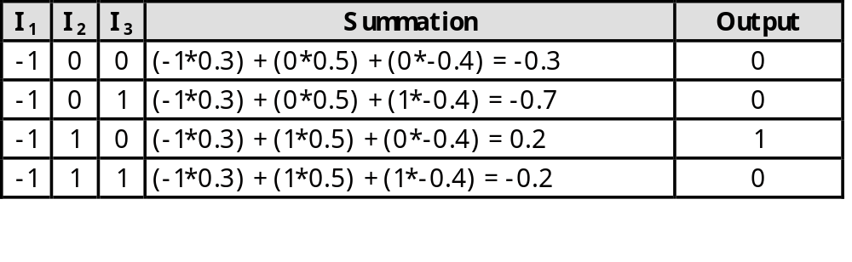
Training Perceptrons
For AND
A B Output
0 0 0
0 1 0
1 0 0
1 1 1
-1
W₁ = 0.3
x
t = 0.0
W₂ = 0.5
W₃ =-0.4
y

Slide 16
Learning in Neural Networks
Learn values of weights from I/O pairs
Start with random weights
Load training example’s input
Observe computed input
Modify weights to reduce difference
Iterate over all training examples
Terminate when weights stop changing OR when error is very small

Slide 17
Decision boundaries
In simple cases, divide feature space by drawing a hyperplane across it.
Known as a decision boundary.
Discriminant function: returns different values on opposite sides. (straight line)
Problems which can be thus classified are linearly separable.

Slide 18
Decision Surface of a Perceptron
x₂
x₂
+
+
+
-
+
-
-
x₁
x₁
+
-
-
+
-
Linearly separable
Non-Linearly separable
Perceptron is able to represent some useful functions
AND(x₁,x₂) choose weights w₀=-1.5, w₁=1, w₂=1
But functions that are not linearly separable (e.g. XOR)
are not representable

Slide 19
Linear Separability
X₁
A
A
A
Decision
Boundary
B
A
A
B
B
B
A
B
A
B
B
X₂
B

Slide 20
Rugby players & Ballet dancers
Rugby ?
2
Height (m)
Ballet?
1
50
120
Weight (Kg)

Slide 21
Hyperplane partitions
A single Perceptron (i.e. output unit) with connections from each input can perform, and learn, a linear separation.
Perceptrons have a step function activation.

Slide 22
Hyperplane partitions
An extra layer models a convex hull
  “An area with no dents in it”
  Perceptron models, but can’t learn
  Sigmoid function learning of convex hulls
  Two layers add convex hulls together
  Sufficient to classify anything “sane”.
In theory, further layers add nothing
In practice, extra layers may be better

Slide 23
Different Non-Linearly
Separable Problems
Types of
Decision Regions
Exclusive-OR
Problem
Classes with
Meshed regions
Most General
Region Shapes
Structure
Single-Layer
Half Plane
Bounded By
Hyperplane
A
B
B
A
B
A
Two-Layer
Convex Open
Or
Closed Regions
A
B
B
A
B
A
Three-Layer
Arbitrary
(Complexity
Limited by No.
of Nodes)
A
B
B
A
B
A

Slide 24
Multilayer Perceptron (MLP)
Output Values
Output Layer
Adjustable
Weights
Input Layer
Input Signals (External Stimuli)

Slide 25
Types of Layers
The input layer.
  Introduces input values into the network.
  No activation function or other processing.
The hidden layer(s).
  Perform classification of features
  Two hidden layers are sufficient to solve any problem
  Features imply more layers may be better
The output layer.
  Functionally just like the hidden layers
  Outputs are passed on to the world outside the neural network.

Slide 26
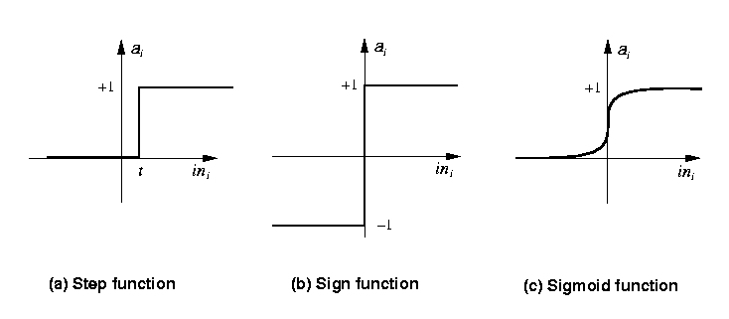
Activation functions
Transforms neuron’s input into output.
Features of activation functions:
  A squashing effect is required
    Prevents accelerating growth of activation levels through the network.
  Simple and easy to calculate

Slide 27
Standard activation functions
The hard-limiting threshold function
  Corresponds to the biological paradigm
    either fires or not
Sigmoid functions ('S'-shaped curves)
  The logistic function
  The hyperbolic tangent (symmetrical)
  Both functions have a simple differential
  Only the shape is important
1
φ(x) =
1 + e ^{-ax}

Slide 28
Training Algorithms
Adjust neural network weights to map inputs to outputs.
Use a set of sample patterns where the desired output (given the inputs presented) is known.
The purpose is to learn to generalize
  Recognize features which are common to good and bad exemplars

Slide 29
Back-Propagation
A training procedure which allows multi-layer feedforward Neural Networks to be trained;
Can theoretically perform “any” input-output mapping;
Can learn to solve linearly inseparable problems.

Slide 30
Applications
The properties of neural networks define where they are useful.
  Can learn complex mappings from inputs to outputs, based solely on samples
  Difficult to analyse: firm predictions about neural network behaviour difficult;
    Unsuitable for safety-critical applications.
  Require limited understanding from trainer, who can be guided by heuristics.

Slide 31
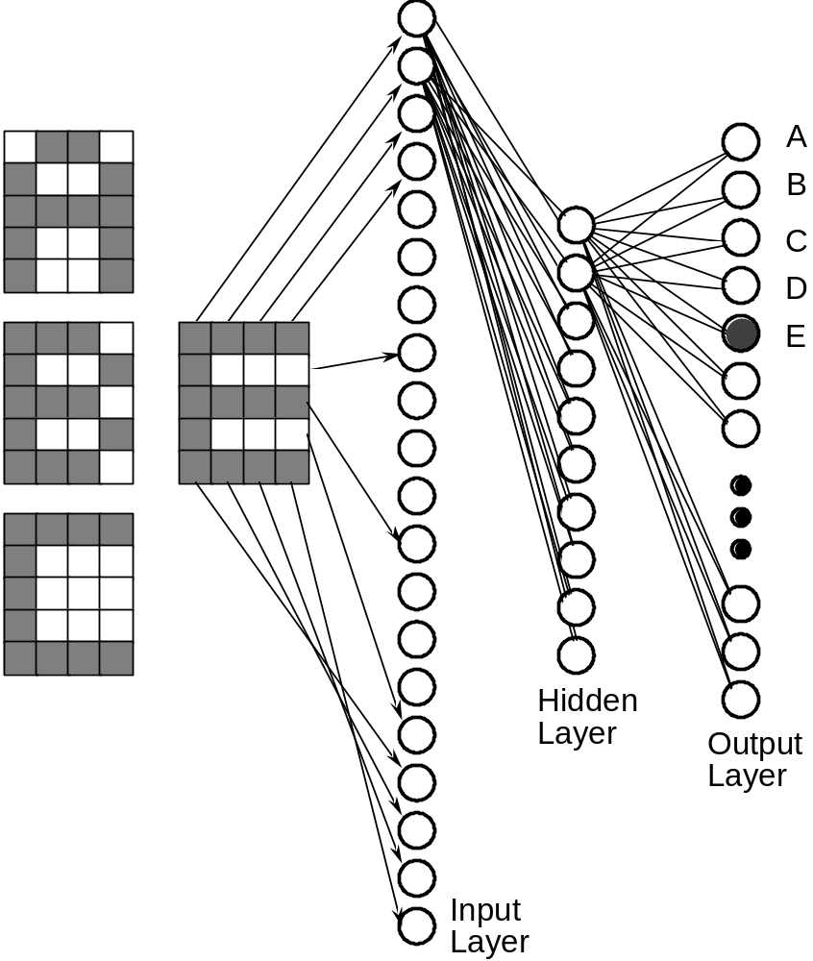
Neural network for OCR
feedforward network
trained using Back- propagation

Slide 32
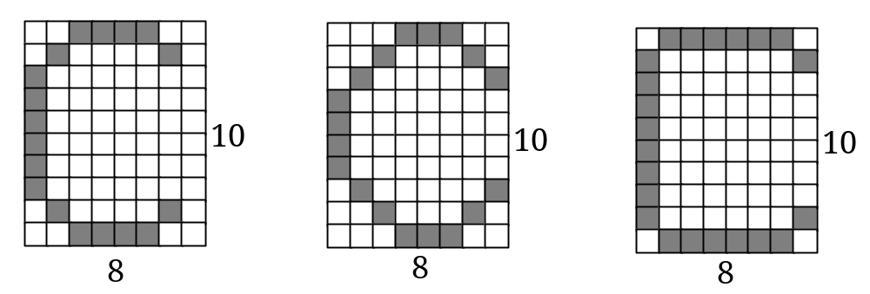
OCR for 8x10 characters
NN are able to generalise
learning involves generating a partitioning of the input space
for single layer network input space must be linearly separable
what is the dimension of this input space?
how many points in the input space?
this network is binary(uses binary values)
networks may also be continuous

Slide 33

Engine management
The behaviour of a car engine is influenced by a large number of parameters
  temperature at various points
  fuel/air mixture
  lubricant viscosity.
Major companies have used neural networks to dynamically tune an engine depending on current settings.

Slide 34
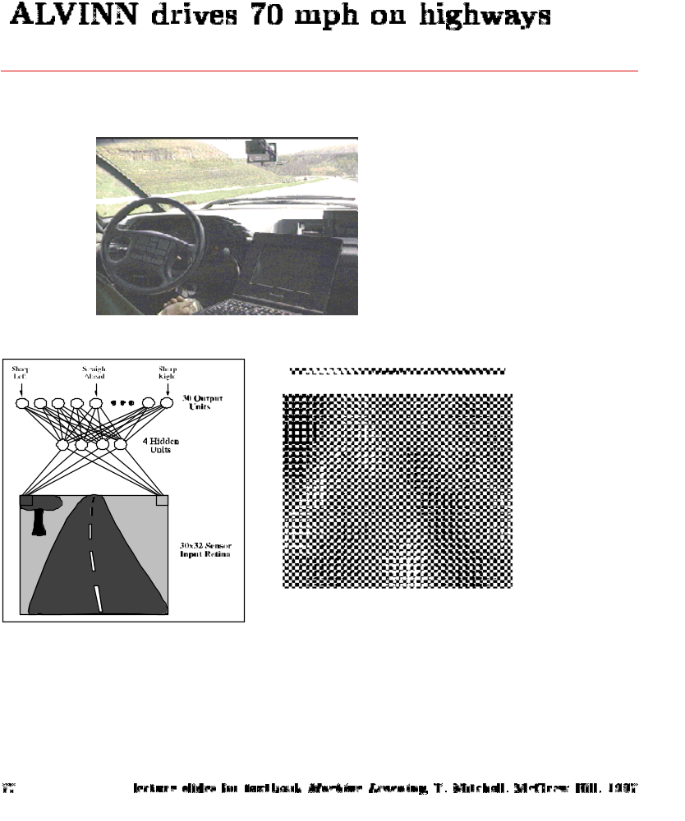
ALVINN
Drives 70 mph on a public highway
30 outputs
for steering
30x32 weights
into one out of
four hidden
unit
4 hidden
units
30x32 pixels
as inputs

Slide 35
Signature recognition
Each person's signature is different.
There are structural similarities which are difficult to quantify.
One company has manufactured a machine which recognizes signatures to within a high level of accuracy.
  Considers speed in addition to gross shape.
  Makes forgery even more difficult.

Slide 36
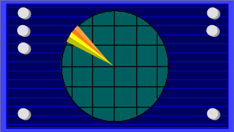
Sonar target recognition
Distinguish mines from rocks on sea-bed
The neural network is provided with a large number of parameters which are extracted from the sonar signal.
The training set consists of sets of signals from rocks and mines.

Slide 37
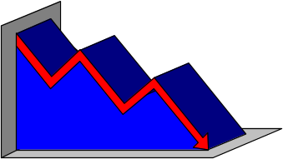
Stock market prediction
“Technical trading” refers to trading based solely on known statistical parameters; e.g. previous price
Neural networks have been used to attempt to predict changes in prices.
Difficult to assess success since companies using these techniques are reluctant to disclose information.

Slide 38

Mortgage assessment
Assess risk of lending to an individual.
Difficult to decide on marginal cases.
Neural networks have been trained to make decisions, based upon the opinions of expert underwriters.
Neural network produced a 12% reduction in delinquencies compared with human experts.

Slide 39
Neural Network Problems
Many Parameters to be set
Overfitting
long training times
...

Slide 40
Parameter setting
Number of layers
Number of neurons
    too many neurons, require more training time
Learning rate
    from experience, value should be small ~0.1
Momentum term
..

Slide 41
Over-fitting
With sufficient nodes can classify any training set exactly
May have poor generalisation ability.
Cross-validation with some patterns
  Typically 30% of training patterns
  Validation set error is checked each epoch
  Stop training if validation error goes up

Slide 42
Training time
How many epochs of training?
  Stop if the error fails to improve (has reached a minimum)
  Stop if the rate of improvement drops below a certain level
  Stop if the error reaches an acceptable level
  Stop when a certain number of epochs have passed

